Slide 1

Real estate investment opportunities in King county
.ATOMAN RESEARCH SOLUTIONS

Slide 2
Atoman Research Services
Maximizing the potential return on an investment in real estate.
Our clients include property developers, builders, real estate investors, and investment banks
Providing data driven advice

Slide 3

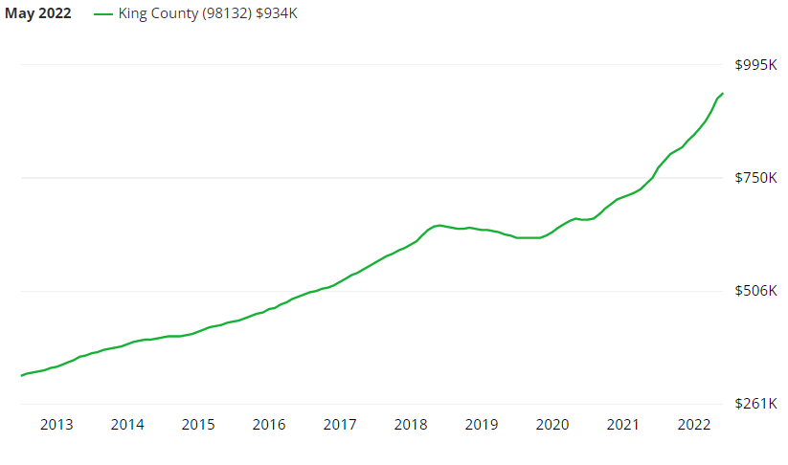
King County metrics
Zillow Home Values Data
Zillow Home Value Index $934k
Consistent growth
Up 24.5% over the past year
Scarce inventory
Seattle 0.64 months
King County 0.82 months

Slide 4
Tools and Data
Dataset: 25,000 properties sales records collected over the last year
Tools:
Simple baseline regression model
Feature engineering
Increasingly complex multiple regression models

Slide 5

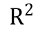
Process
Optimize price per square foot
Start with a simple baseline model
Use a multiple linear regression model for inferential analysis
Engineer features that improve the performance and remove insignificant features
$$R^{2}$$

Slide 6

Impactful features
Zip codes
98004, 98103, 98115, 98112, 98003
Seattle, Bellevue, Clyde Hill, Beaux Arts Village, Hunts Point
Building materials grade (-24.12 coefficient)
Waterfronts (19.63 coefficient)

Slide 7
Zip code correlation coefficients

Slide 8
Mean price per square foot in top zip codes

Slide 9

Conclusion and next steps
Strong predictors of price per square foot
Zip codes
Building grade
Waterfront
Next steps
Add more features
Address variable interaction

Slide 10
Contact information
Tom Chapman – thomas.h.chapman@gmail.com
Anton Smirnov – antonalekssmirnov@gmail.com

